Slide 1

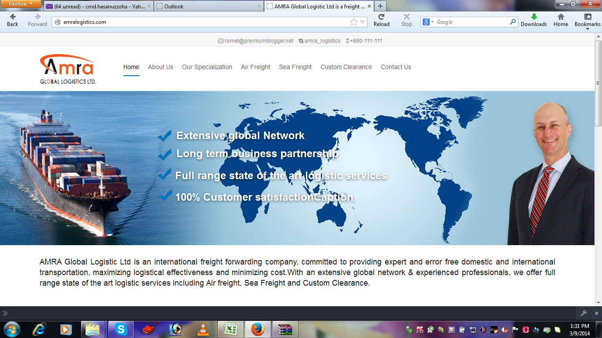
Seamless Supply Chain Solutions
AMRA GLOBAL LOGISTICS LTD

Slide 2
AMRA GLOBAL LOGISTICS LTD
ABOUT US
AMRA GLOBAL LOGISTICS LTD established in Bangladesh as a company specializing in total logistics, offers our customers a wide range of customized global logistics and sourcing solutions.."
AMRA GLOBAL LOGISTICS LTD is a rapidly expanding, full freight forwarding & international logistics customs brokerage located in Bangladesh. Our diversified services to meet your various needs including air and ocean transportation, group age, distribution, logistics, bonded and non-bonded warehousing, customs brokerage with licensed, projects. Depending on our domestic and global network, AMRA GLOBAL LOGISTICS LTD provides high efficiency total logistics solution. We believe our years of experience and attention to detail fill a niche in today's active market.
AMRA GLOBAL LOGISTICS LTD is a leading shipping service provider in Bangladesh. In addition to our core businesses of port agencies, we offer a full range of related services to ship owners and ship operators.
In this dynamic and challenging business, our mission at AMRA GLOBAL LOGISTICS LTD services is to be recognized by our valued customers as the undisputed leader in services to the shipping, C & F and Freight Forwarding industry.
Adopting an international recognized quality management standard. Application of marketing concept to maximize customer satisfaction. Strategic marketing plans and professional management, who are committed to staff development.
AMRA GLOBAL LOGISTICS LTD

Slide 3
AMRA GLOBAL LOGISTICS LTD
Our Vision & Our Mission
Vision :
“ Customized Logistics Solution Provider ”
Mission :
  Market research & Client Analysis to fully understand Clients’ needs.
  Suitable & cost effective solution for Clients.
  Develop Business Channels that connect everywhere in the World with profitability & sustainable growth.
  Continuous Service Improvement through Innovation, Flexibility & Adaptability.
  Trained & Professional Workforce with a feeling inside “I AM RUNNING MY OWN BIZ & THIS IS MY BABY!”
AMRA GLOBAL LOGISTICS LTD

Slide 4
AMRA GLOBAL LOGISTICS LTD
Our Values :
Value Based Organization
  Providing clear guidelines for interpersonal behavior
  Values agree, “lived” and living the values measured
  Organizational Capability through
  Clean and simple process
  Skilled people empowered to do the job
  Continuous development
  Performance management
  Transparent and fair reward systems
  Base pay at market average
  Incentives linked to team and individual performance
AMRA GLOBAL LOGISTICS LTD live, learn and teach the traditional Values of the World-Wide Family - Trust, Respect, Responsibility, Loyalty, Solidarity, Harmony & Prosperity.
AMRA GLOBAL LOGISTICS LTD

Slide 5
AMRA GLOBAL LOGISTICS LTD
O
U
R
V
A
L
U
E
S
Internal & External Survey, September 2010
AMRA GLOBAL LOGISTICS LTD

Slide 6
AMRA GLOBAL LOGISTICS LTD
SCOPE OF SERVICES:
FREIGHT FORWARDING
  Sea Freight
  LCL Consolidation (MCC & SCC)
  Air Freight
  Buyer Consolidation
PROJECT HANDLING
NVOCC
SHIPPING AGENCY
CUSTOMS BROKER
AMRA GLOBAL LOGISTICS LTD

Slide 7
AMRA GLOBAL LOGISTICS LTD
1. SEA FREIGHT
AMRA GLOBAL LOGISTICS LTD, offers inbound and outbound services for both LCL (Less Cargo Load) and FCL (Full Cargo Load). We have special contract rates with some of the leading main line operators with service coverage to and from all major ports and destinations. A multi model door delivery transportation model is also available
Like us, our worldwide Associates are well established and reputed Organizations and have the same philosophy of rendering you the UNMATCHED SERVICE at all times.
Key Account (Export)
WAL-MART (CANADA)
INDITEX (ZARA)
TSCO (AUSTRILIA)
HTS (SPAIN)
BOSTON (SPAIN)
SPERA (SPAIN)
NECK & NECK (SPAIN, MAXICO)
EL-CORTE (SPAIN)
SMITH CLOTHING (AUSTRALIA)
MDR (AUSTRILIA)
PIVILION (ZARA)
UNIFORM UNIVERSAL (SPAIN)
FICOESA (SPAIN)
Key Account (Export)
PHILHOBAN DESIGN (CANADA)
JEANS WAR-WICK INDST (CANADA)
WM INC (CANADA)
WINNPEG PANTS + SPORTS WEAR MFG LTD (CANADA)
ALANN MARKS (FRANCE)
VIA FORUM (FRANCE)
TARCO SA (ARGENTINA)
TREND MILLS SA (ARGENTINA)
PREMIER P LTD (UK)
MARKS & SPENCER (UK)
GROUPE CASINO (FRANCE)
FINSBURY (UK)
AMRA GLOBAL LOGISTICS LTD

Slide 8
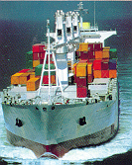
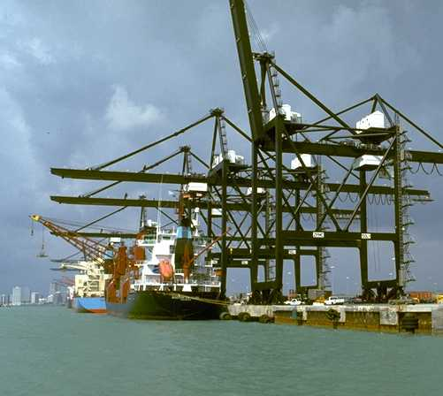
AMRA GLOBAL LOGISTICS LTD
Seamless Supply Chain Solutions
  Ocean Freight Management
    Only issuer of Direct B/L (Consigned to Partner )
    Proactive vendor conference
    PO Management
    Online Shipment Status
    Transshipment port monitoring
    Training & Review
    Error free documentation by suppliers
    Cargo sorting & repacking.
    Performance analysis and reduced lead time
    Storage
AMRA GLOBAL LOGISTICS LTD

Slide 9
AMRA GLOBAL LOGISTICS LTD
AMRA GLOBAL LOGISTICS LTD is almost working with All the MLO’s :
APL Line
NYK Line
Maersk Line
OOCL Line
HAPAG Line
Hundai Line
CMA CGM Line
Hanjin Line
COSCO Line
Evergreen Line
1.1 IMPORT
All Major Origins Covered
Fixed Weekly Departures
Fastest Transit Times
Competitive Rate Structures
Competitive Ex-Works Costs
1.2 EXPORT
Service to worldwide destinations
Door to door pick-up and deliveries
Worldwide network of agents.
Cargo tracking system
AMRA GLOBAL LOGISTICS LTD

Slide 10
AMRA GLOBAL LOGISTICS LTD
  Customs Brokerage
With more than a decade of experience, AMRA GLOBAL LOGISTICS LTD is a leading service provider of full-swing customs brokerage, local, ocean and air cargo distribution, Inter transportation and distribution. As one of the largest-volume customs entry filers in Bangladesh, we handle more than three hundred transactions annually. Our customs brokerage services shall help to speed up your shipments through customs clearance, Comprehensive service is provided all over Bangladesh having over 12 licensed Customs brokers and our qualified customs specialists and professionals in Dhaka, Chittagong and Benapole. -Management of imports and exports via land, sea and air. Duty and tax calculation, Customs bond issues, any protest preparation and filing, comprehensive expert analysis on HS Code and duty structure. Company equipped with an Expert sourcing of suppliers, Importer and buyers. They quashing on indemnity bonds. . AMRA GLOBAL LOGISTICS LTD is your one-house solutions for customs brokerage needs initiating from classification, to clearance and post-entry services. Our uniform work processes and professional abilities ensure that the right procedures are adopted at the outset of any operation. AMRA GLOBAL LOGISTICS LTD has the resources, the people and the technology to provide excellence of performances in customs brokerage services,. For more information, contact the logistics department of AMRA GLOBAL LOGISTICS LTD .
Mission Statement: HELPING YOUR BUSINESS IS OUR BUSINESS!
AMRA GLOBAL LOGISTICS LTD

Slide 11
AMRA GLOBAL LOGISTICS LTD
  LCL Consolidation (MCC & SCC)
2.1 Outbound Groupage:
As a commitment to providing world class service, AMRA GLOBAL LOGISTICS LTD, has endeavored to establish fixed date stuffing for world wide distribution, in consonance with shipping schedules of premium carriers. AMRA GLOBAL LOGISTICS LTD operations are smoothened out with the help of our Associates who are strategically located across the world. They are essentially hand picked professional organizations linked up to form a highly response-led and effective AMRA GLOBAL LOGISTICS LTD global network.
MCC routing via SIN to WORLD-WIDE
SCC (Direct Consol) to Spain / Canada / France / Rotterdam
AMRA GLOBAL LOGISTICS LTD

Slide 12
AMRA GLOBAL LOGISTICS LTD
2.2 Inbound Groupage:
Working through an extensive global network of Associates and innovative routings AMRA GLOBAL LOGISTICS LTD, ensures that inbound freight into Bangladesh are economical, effective and time-bound as far as deliveries are concerned. That’s More Value to Customers.
2.3 Door-To-Door Logistics:
AMRA GLOBAL LOGISTICS LTD, specializes in offering services that span Shipping Documentation, Custom Clearances, Cargo Insurance, Warehousing and Local Distribution as a part of its Door-to-Door Logistics Service. That's the Convenience of a Single Window Advantage.
AMRA GLOBAL LOGISTICS LTD

Slide 13
AMRA GLOBAL LOGISTICS LTD
3. AIR FREIGHT
3.1 Outbound Air Freight Services:
With an in-house IATA accredited company, AMRA GLOBAL LOGISTICS LTD, provides comprehensive air freight services from Bangladesh including door-to-door services. Extending the advantages of house airway bills, Bangladesh Bank Approvals for outbound consolidation, insured warehouse facilities close to airports with state-of-the-art stacking, on-line cargo Tracking on, in-house customs clearance and own vehicles for cargo pick- up. That’s a Constructive Build up.
AIR Key Account:
INDITEX (ZARA)
SPERA (SPAIN)
PIVILION (ZARA, SPAIN)
UNIFORM UNIVERSAL (SPAIN)
FICOESA (SPAIN)
AIR Key Account:
WM INC (CANADA)
WINNPEG PANTS + SPORTS WEAR MFG LTD (CANADA)
ALANN MARKS (FRANCE)
TARCO SA (ARGENTINA)
MARKS & SPENCER (UK)
FINSBURY (UK)
AMRA GLOBAL LOGISTICS LTD

Slide 14

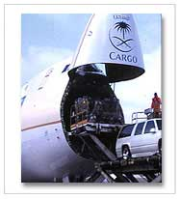
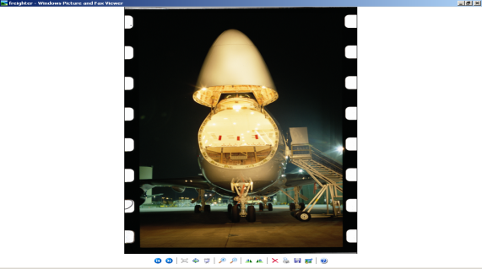
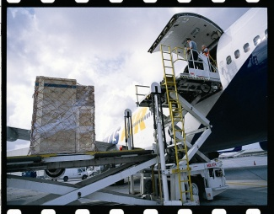
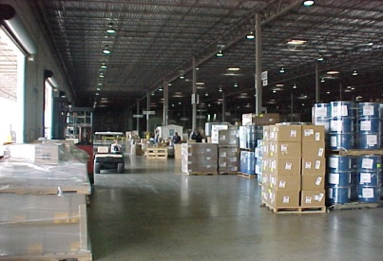


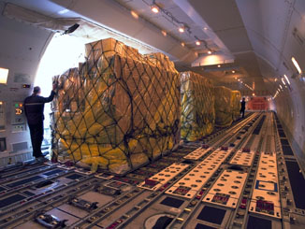
AMRA GLOBAL LOGISTICS LTD
Seamless Supply Chain Solutions
Air Freight Management
  Time Definite Product
  Guaranteed space on regular Freighter
  Equipment & Space management in peak season
  Long Term Storage
  Regular Freighter Operation
  Proactive Collaborations
3. AMRA GLOBAL LOGISTICS LTD Stock Holders
Qatar Airways
Saudi Arabian Airlines
Thai Airways
Emirates
OPERATION
WAREHOUSE
CUSTOMER
CARRIER
TRANSSHIPMENT
PORT
AMRA
SUPPLIER
DESTINATION
PLANNING
AMRA GLOBAL LOGISTICS LTD

Slide 15
AMRA GLOBAL LOGISTICS LTD
3.2 - Inbound Air Consolidation Services:
A committed and efficient team of professionals at AMRA GLOBAL LOGISTICS LTD have developed an exhaustive world wide network of associates and an effective chain supply system to cater to demanding customers. Together with highly responsive and dynamic global partners, AMRA GLOBAL LOGISTICS LTD provides time -bound and cost effective services always.
AMRA GLOBAL LOGISTICS LTD

Slide 16
AMRA GLOBAL LOGISTICS LTD
  Sea - Air Management
  Transit Time : 9-10 Days (CTG - CBO - European Dest.)
    Transit Time : 10-12 Days (CTG - CBO - USA/Canada Dest.)
    Transit Time : 15-16 Days (CTG - DXB - European Dest.)
    Transit Time : 16-18 Days (CTG - DXB - USA/Canada)
    Cost Saving : 10% - 20% during Lean Season
    Cost Saving : 20% - 30% during Peak Season
    Sailings/Week : 2/Week, EX-CTG
    Arrival in CBO/Week : 2/Week
    Arrival in DXB/Week : 1/Week via CBO, 1/Week via SIN
    Transshipment Port : CBO/DXB
    Efficient Handling, reliable Carrier in DXB/CBO
AMRA GLOBAL LOGISTICS LTD

Slide 17
AMRA GLOBAL LOGISTICS LTD
4. BUYER CONSOLIDATION:
Buyer Consolidation is our core activity and capability. We can receive cargo from multi vendors at any of our warehouses and custom load containers to suit your requirements. This would translate into more speedy delivery at destination and the container can be unloaded at the stores directly.
We are continuously striving to provide logistics solutions to our customer which gives them the leading edge information on their products. We have a broad menu of services that covers the whole supply chain management and on-time information on the products.
AMRA GLOBAL LOGISTICS LTD can also provides to its customers both Origin and Destination services pertaining to their valuable cargoes.
AMRA GLOBAL LOGISTICS LTD is well connected globally to serve the customer by giving real-time information on the product as it travels through supply chain. Your information security is our prime concern. Each customer needs to register with AMRA GLOBAL LOGISTICS LTD in order to avail of this service and ensures security. We also have EDI transfers that can be tailor-made to suit your information requirements.
AMRA GLOBAL LOGISTICS LTD

Slide 18
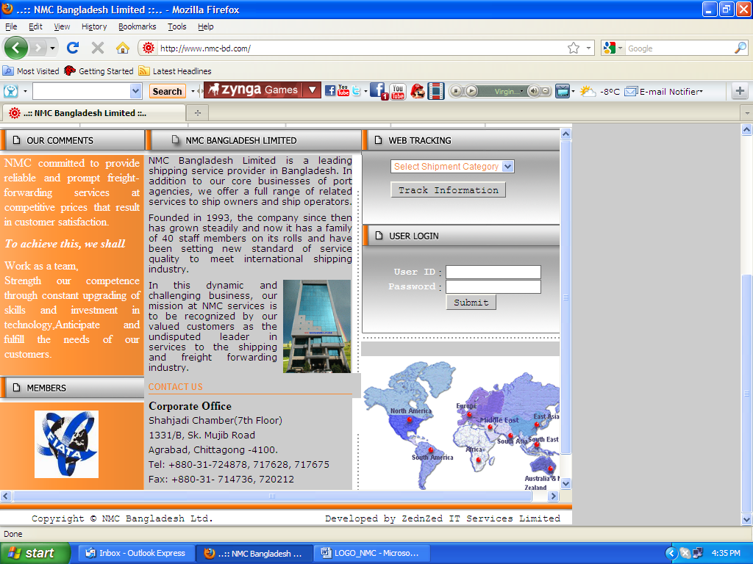
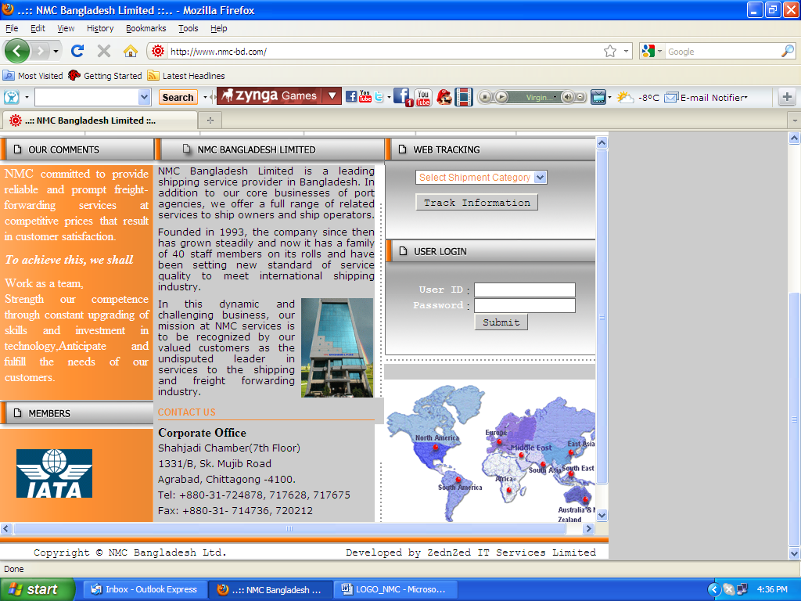
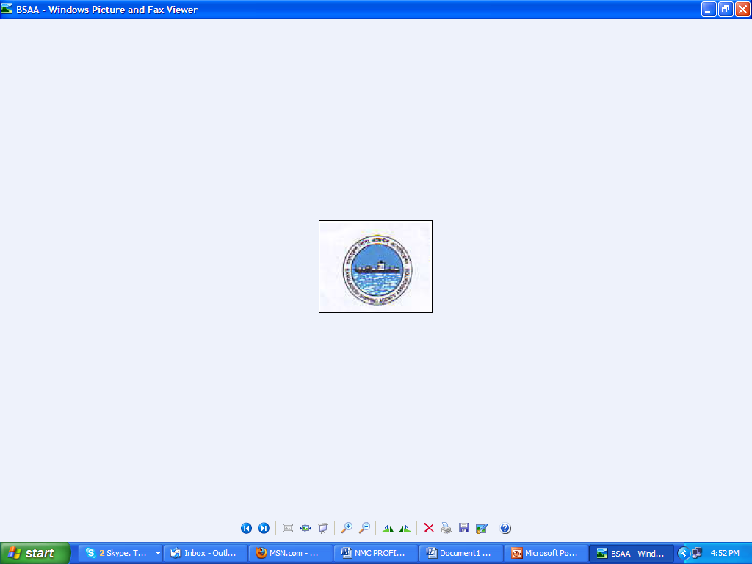


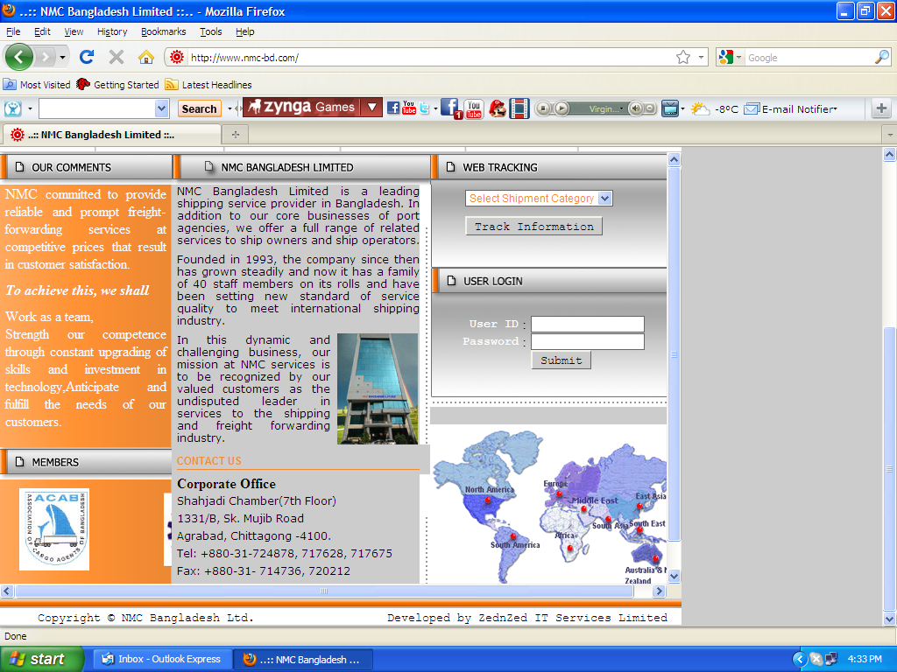
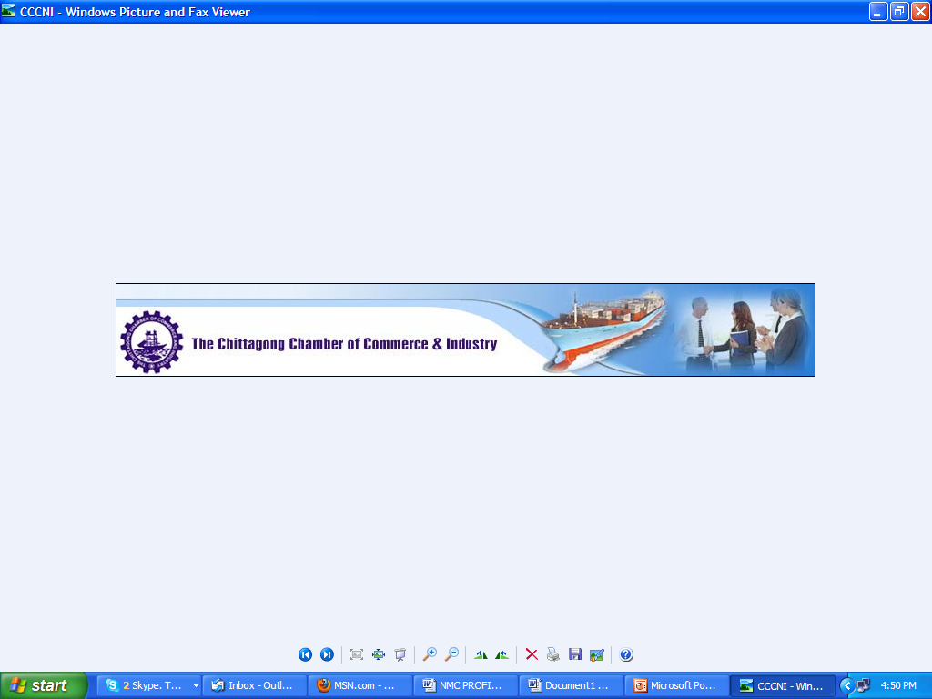
AMRA GLOBAL LOGISTICS LTD
AMRA GLOBAL LOGISTICS LTD (and other AMRA GLOBAL LOGISTICS LTD associates) having legal right to issue Carrier Bill of Lading Consigning to partner/agent.
AMRA GLOBAL LOGISTICS LTD
believe in Transparent Business and trustworthy relationship with all concerned parties and acknowledge our responsibility in doing so.
Certification
NB: We have Certified Copies of the Judgment.
AMRA GLOBAL LOGISTICS LTD

Slide 19
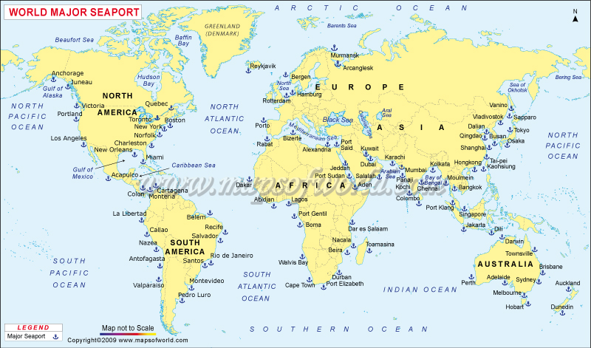
AMRA GLOBAL LOGISTICS LTD
Our Presence & Coverage :
AMRA GLOBAL LOGISTICS LTD
Networks can be found in almost every major Sea Ports across the World and we are closing almost every day our MCC box via Singapore.
AMRA GLOBAL LOGISTICS LTD

Slide 20
AMRA GLOBAL LOGISTICS LTD
WHO WE ARE ?
Channel
Development
Demand Creation /
Market Development
Market
Intimacy
Multi-brand
Management
Relationship
Management
Capability
Competency
Culture
Information
Services
HR
Performance/
Finance / IT
Account
Development
Communication
HR
Services
Quality
Surveillance &
Mgmt
Technical
Support &
Infrastructure
Market Execution
Demand Fulfillment &
Customer Delight
Order
Generation
People
Development
Financial
Services
Asset
Development
& Care
Merchandising
Service to
Demand
Demand
& Delivery
Planning
Operation
Planning
Distribution &
Warehousing
SCM Solution
AMRA GLOBAL LOGISTICS LTD

Slide 21
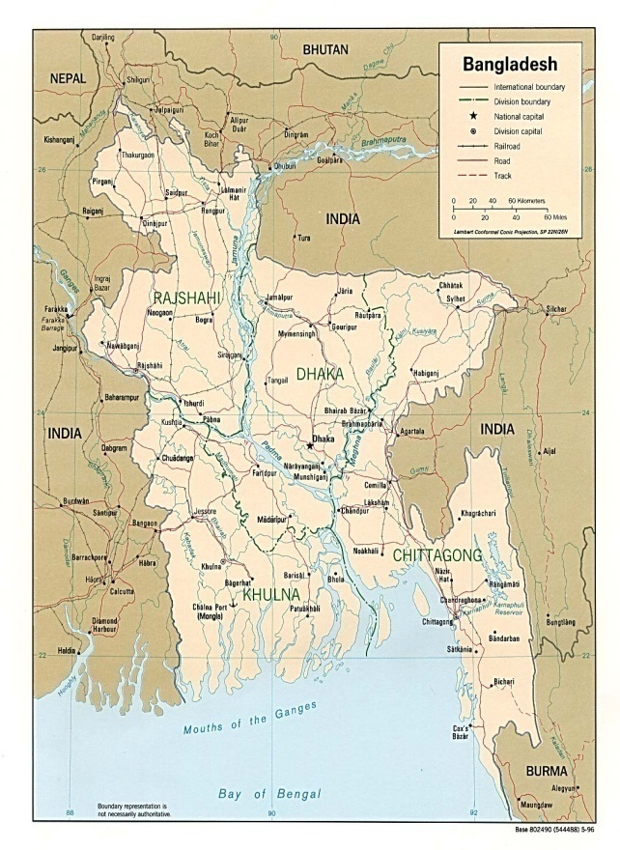
AMRA GLOBAL LOGISTICS LTD
Offices :
Dhaka Office
Gulshan Plaza-Ta-137/1 (2nd Floor),
Bir Uttam A.K.Khandakar Sarak
Gulshan Link Road , Gulshan-1,
Dhaka-1212, Bangladesh.
Chittagong Office
Rahman Hights (4th Floor),
1125/A, B Nag Lane,Goshaildanga,
Agrabad, Chittagong, Bangladesh.
Airport Office
Cargo Terminal Village
Shahjalal Air Port, Dhaka.
For
Customer’s Around DHAKA
For
Customer’s Around CTG
AMRA GLOBAL LOGISTICS LTD

Slide 22
AMRA GLOBAL LOGISTICS LTD
THANK YOU
AMRA GLOBAL LOGISTICS LTD

